Slide 1

Road accident statistics
Victoria
2014-2019

Slide 2
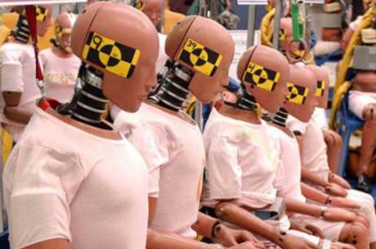
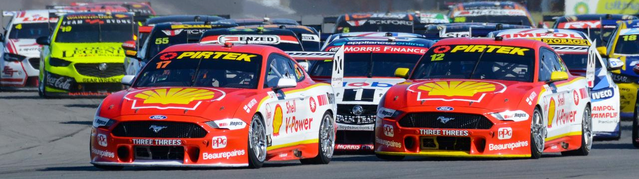
THE Team
Stuart Karpin
Kaayin Kee
Ajay Bandara
Jing Davies

Slide 3

Disclaimer:
Data on this presentation was obtained from the sources named in this article from the latest available data as at March 2021.
The team does not guarantee the accuracy or completeness of the data and accepts no liability whatsoever arising from or connected in any way to the use or reliance upon this data.

Slide 4

Quick Stats (2020)
1,195 people were killed in road-related deaths, over 3 people per day
36% of fatal crashes occur in major cities
Single vehicle accidents made up just under 50% of fatal crashes in 2019
Every year since 1970 has been a decrease in the road death

Slide 5
About The Project
Between 2014 and 2019, there are over 77,000 recorded road accidents in Victoria.
That is average 42 accidents per day.
Thanks to:
VicRoads who provided the dataset which shows the road crashes for the 5 years.
Bureau of Meteorology who provided the dataset shows the daily rainfall for the 5 years.
Data Source:
https://discover.data.vic.gov.au/dataset/road-crashes-for-five-years-victoria
http://www.bom.gov.au/jsp/ncc/cdio/weatherData/av?p_nccObsCode=136&p_display_type=dailyDataFile&p_startYear=2020&p_c=-1487197977&p_stn_num=086232

Slide 6

Questions
Which city in Victoria has the most number of accidents?
Does the day of the week affect number of accidents?
What’s the relationship between rainfall and road accidents?
Is there any relationship between the Rainfall and Hit And Run accidents?
Do accidents in dead end roads involve alcohol?
Has the number of accidents been increasing or decreasing over the years? Why?
What is the type of accident that happens the most?
What is the relationship between light condition and road accidents?

Slide 7


Slide 8
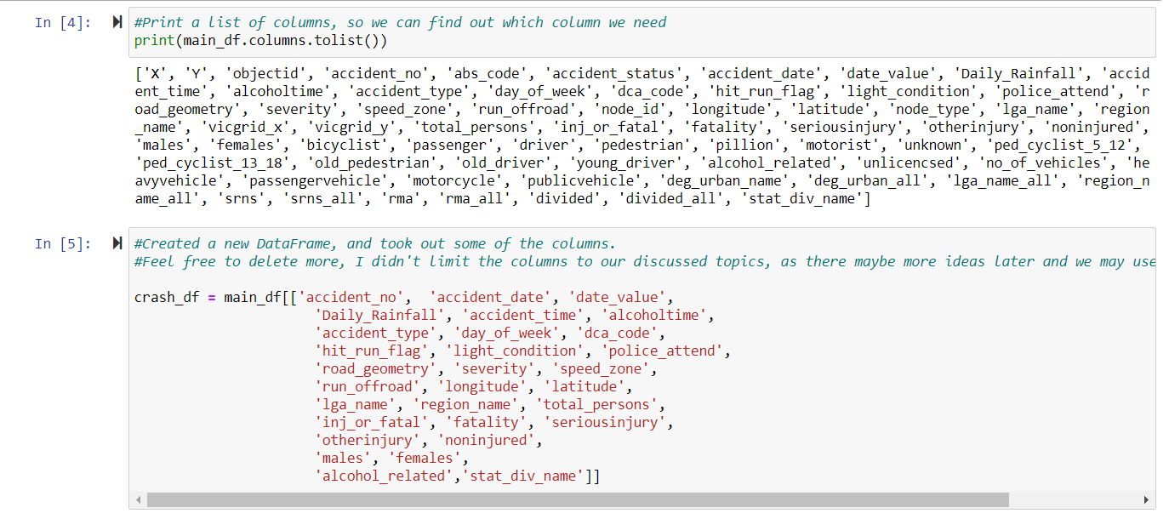
Clean up

Slide 9
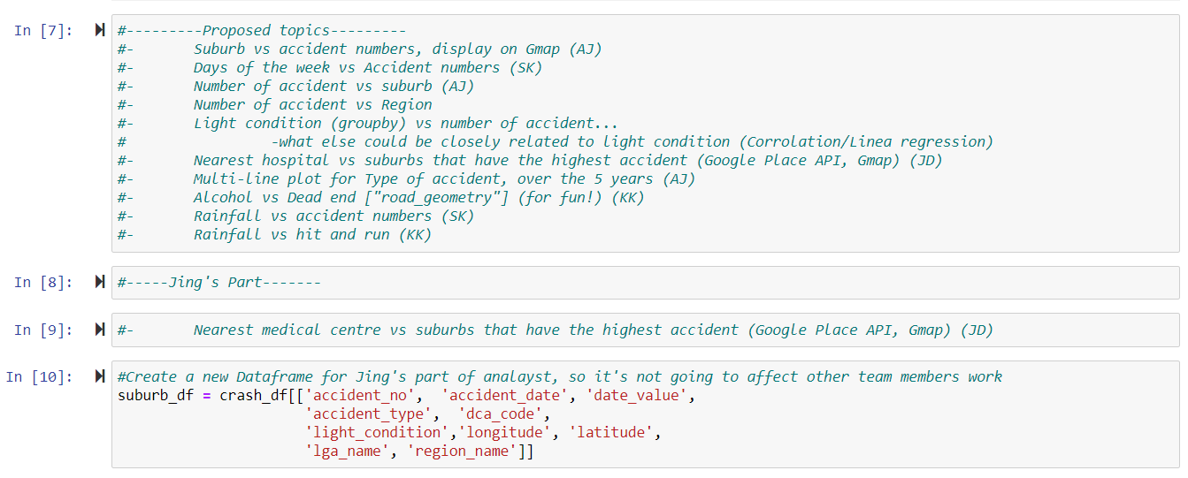
Divide the work

Slide 10
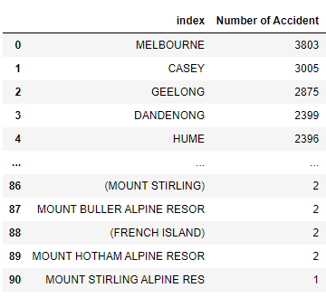
Number of total accidents in each City (2014-2019)

Slide 11
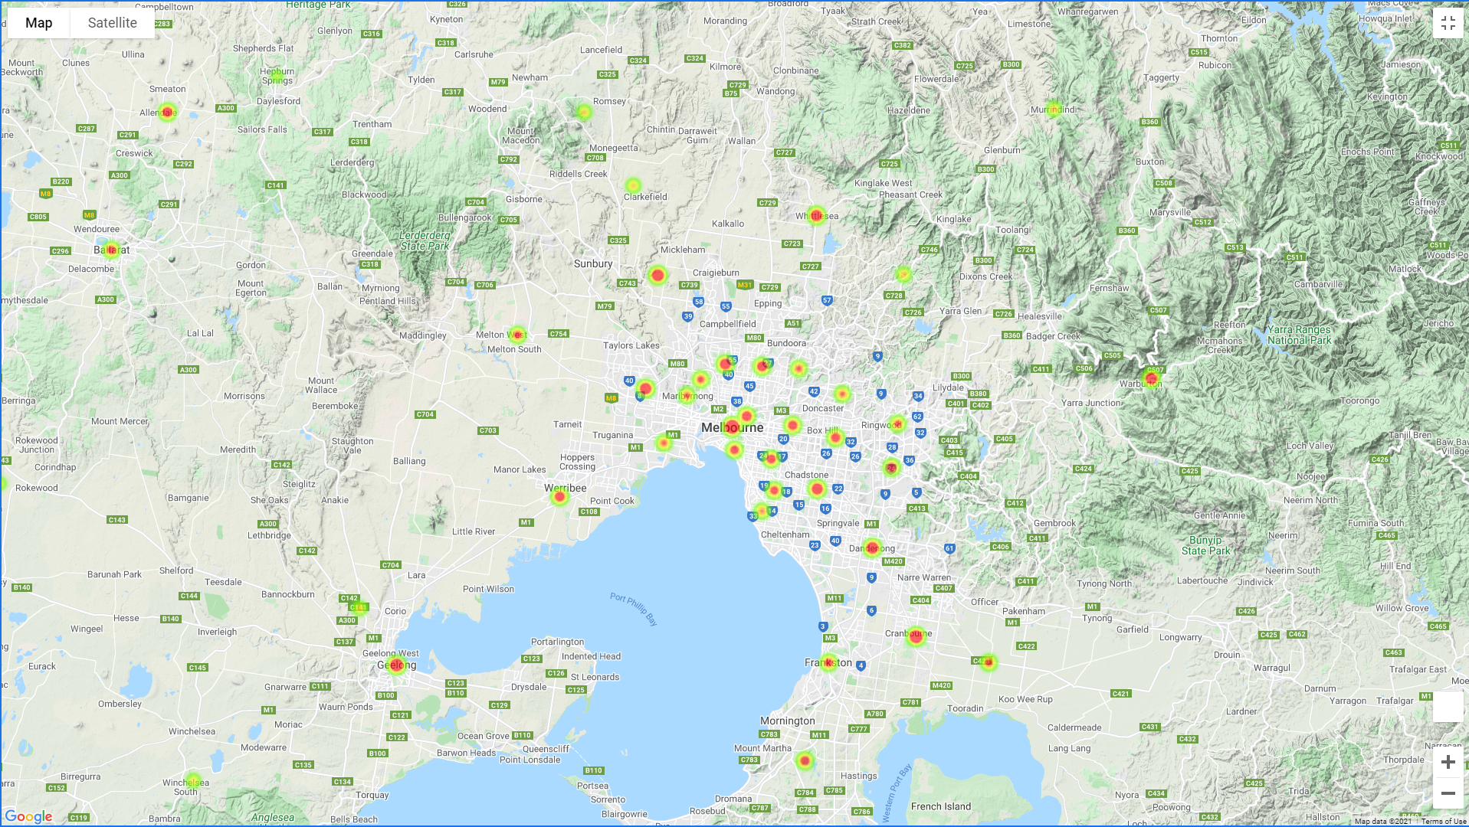

Slide 12
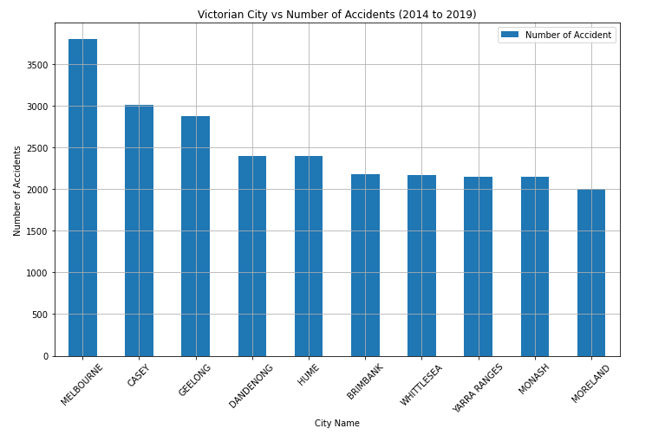

Top Ten cities with most accident numbers

Slide 13

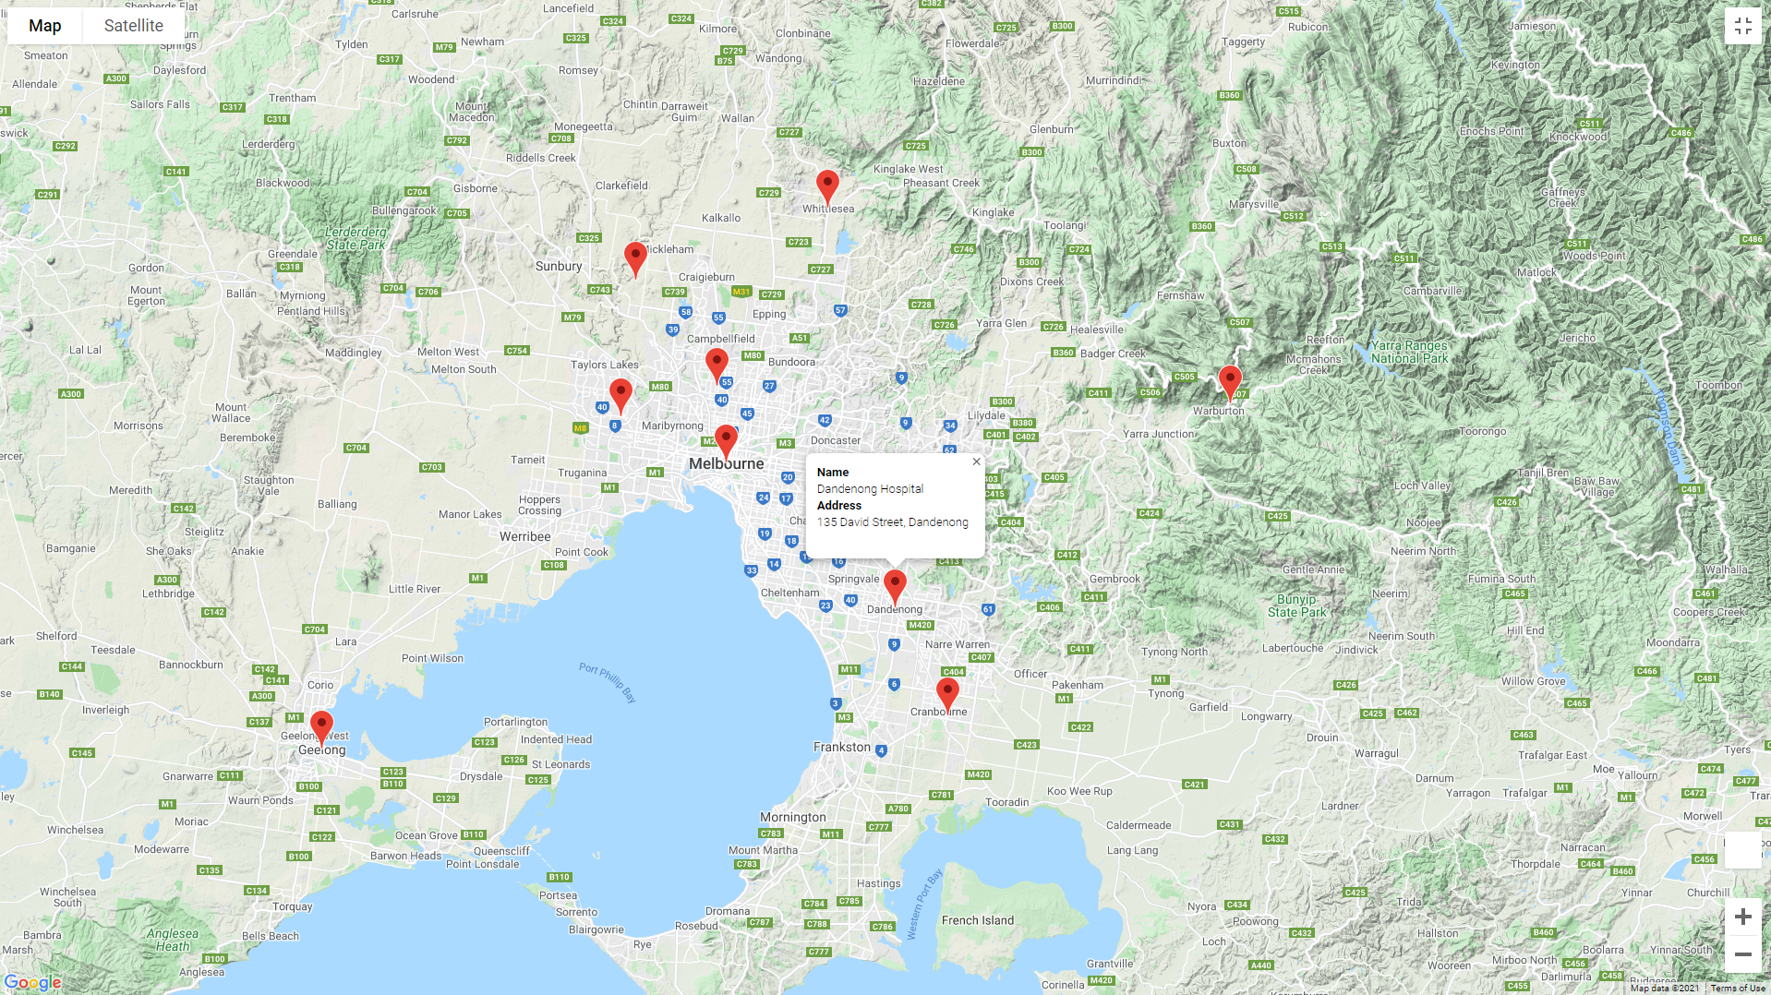
Nearest medical centre

Slide 14
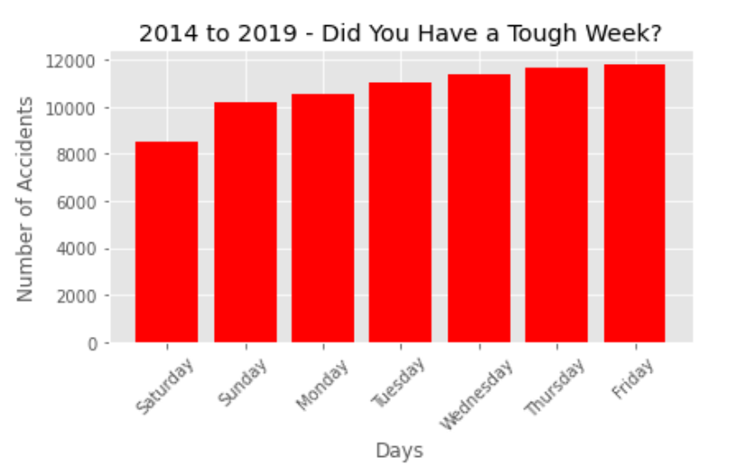
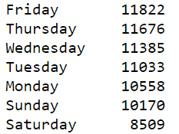

Does the day of the week affect number of accidents?

Slide 15
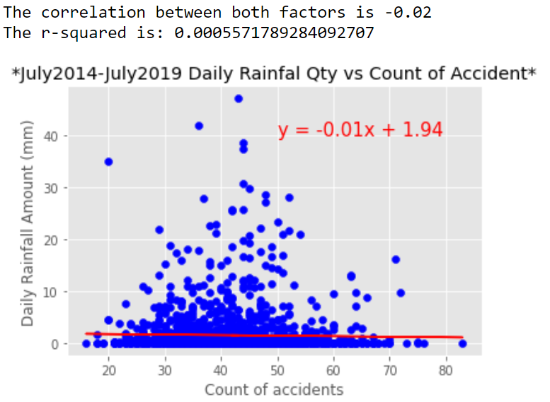
What’s the relationship between rainfall and road accidents?

Slide 16
Is there a correlation between rainfall and hit-and-runs?
Notes:
The reason we chose this topic specifically is because we stumbled across some parameters in the data that we were not expecting to be there, such as whether or not an accident was a hit-and-run. The imagery was too striking to not consider – a person hitting someone or something and then not being bothered to get out of their car because of heavy rain

Slide 17
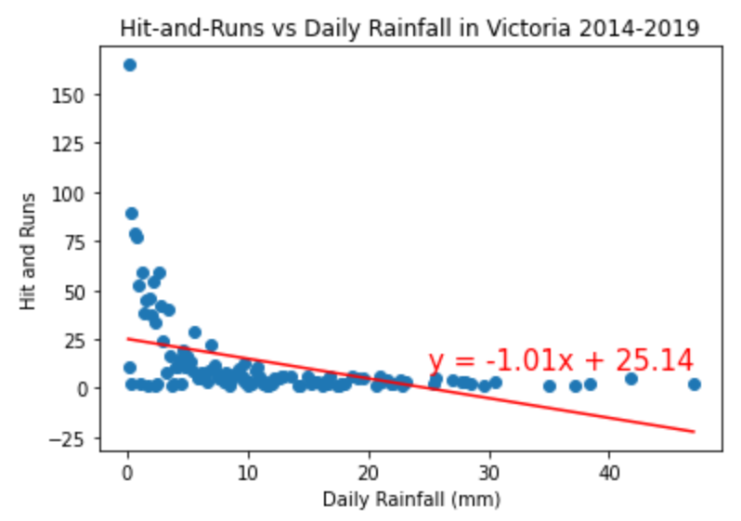
Notes:
Nevertheless, I plotted the number of hit-and-runs against the instances of each level of rainfall to find and find a regression. Here you can see that the instances of hit and runs for each level of daily rainfall are mostly low, but there are more on days with low levels of rainfall, which has shaped the line of regression like this. We do see a bit of a slope here but ultimately the calculated r-squared value was 0.19 which according to pearson’s correlation coefficient is no correlation.

Slide 18
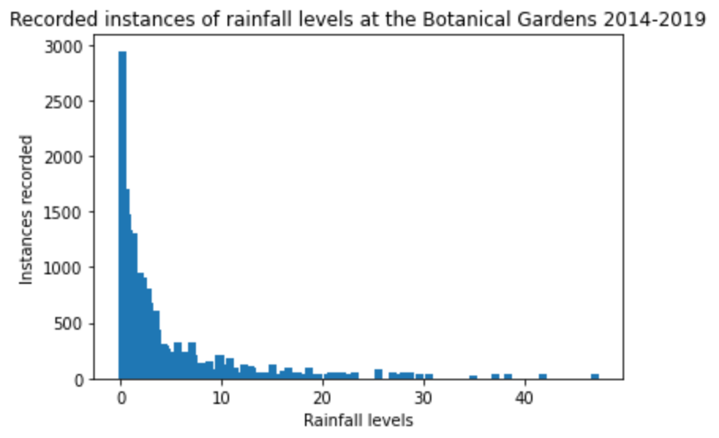
Is our rainfall data reliable?
Notes:
I’ve written ‘reliable’ but should probably say ‘suitable’ here. I realised there were a lot more instances of not very wet days, which would mean we would first have to find the likelihood of it raining before we could really say whether or not there is a connection between rainfall and hit-and-runs. Additionally, although we’ve used crash data for the whole of Victoria, we’ve taken rainfall data from only a central point in Melbourne, so the Botanical Gardens. I’m not sure how variable the rainfall is across Victoria but that isn’t something we’ve taken into consideration for our project.

Slide 19
Is there a connection between alcohol consumption and road accidents at dead ends?
Notes:
In a similar spirit to the previously explored question, we noticed that accidents happen at dead ends and wondered how that could be possible.

Slide 20
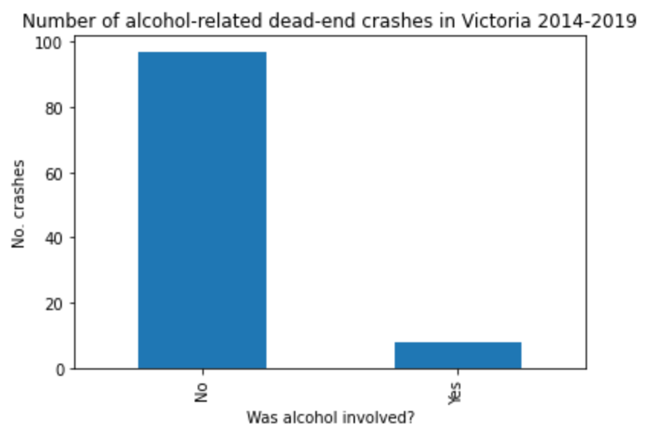

Slide 21
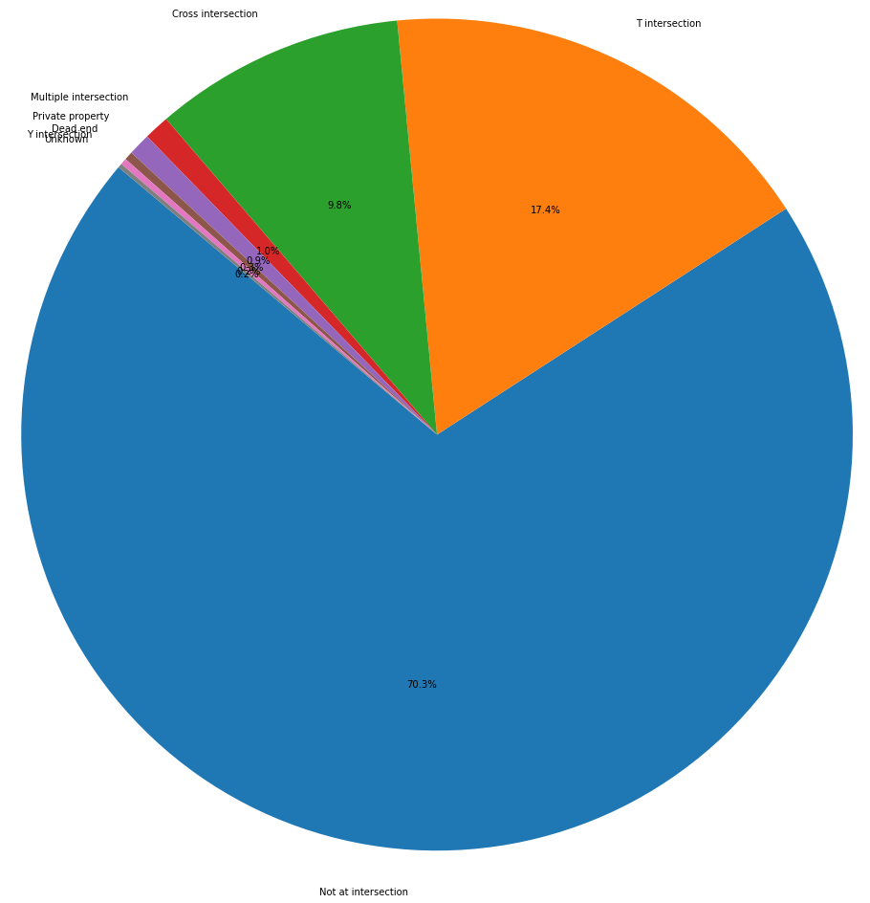

Slide 22
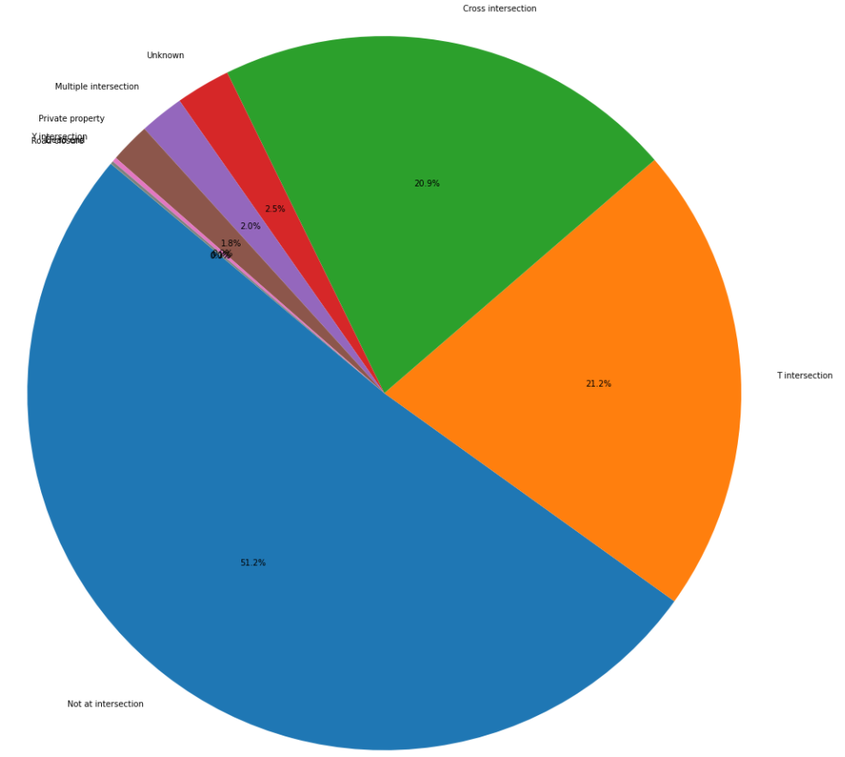

Slide 23
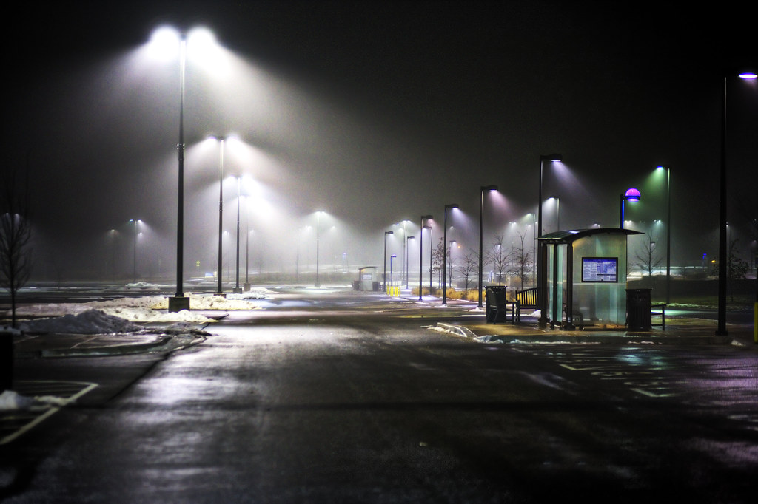
Is there connection between light condition and accidents?

Slide 24
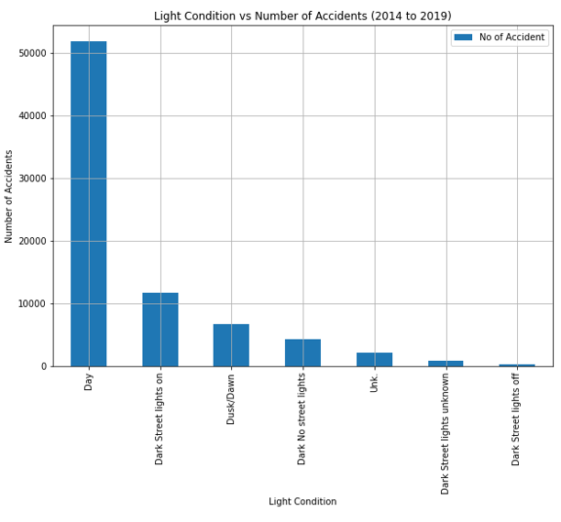

Slide 25
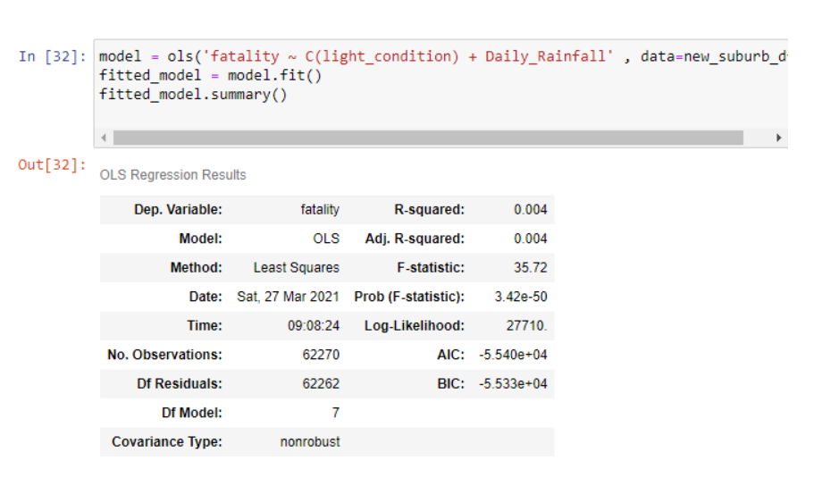

Slide 26
Accident Rate over 4 year period?

Slide 27
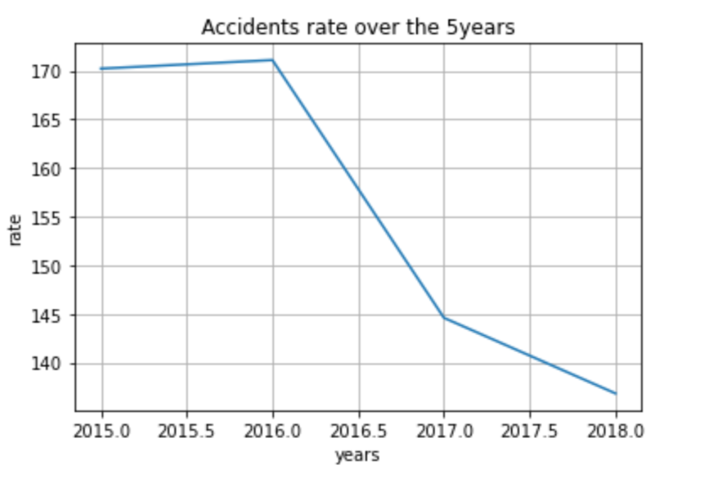
Highest rate :
2015 & 2016

Slide 28
Possible reasons for the decrease?
Advanced technologies
Road fines
stricter road safety laws
More cars registered?
Safer vehicle standards

Slide 29
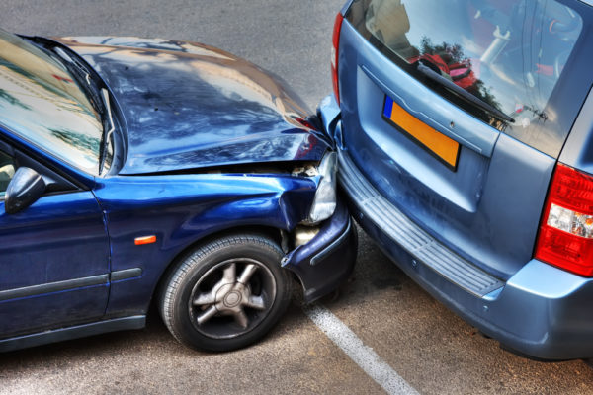
TYPES OF ACCIDENTS OVER 4 YEAR PERIOD

Slide 30
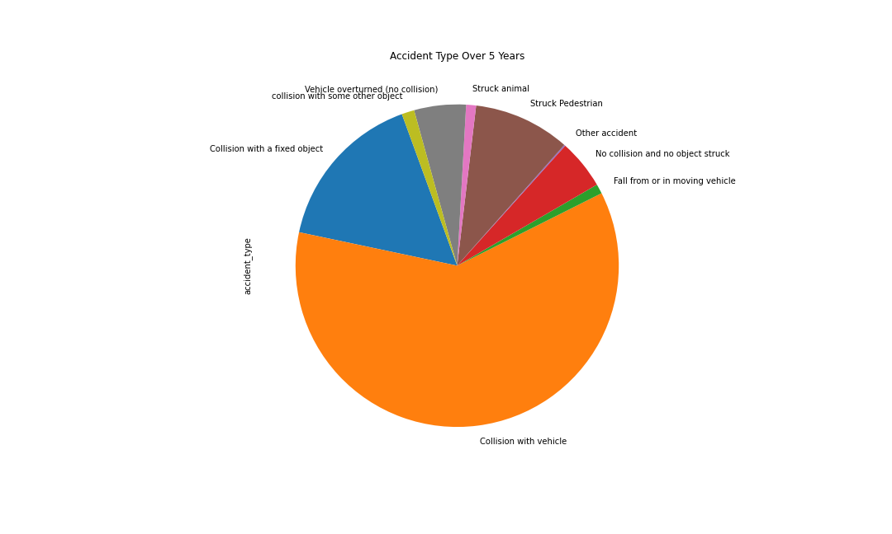

Slide 31
No of accidents based on the region

Slide 32
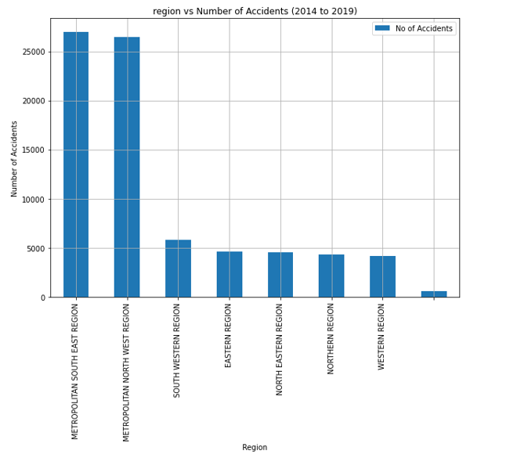

Slide 33

QUESTIONS?

